Slide 1
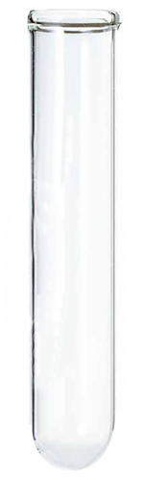



A new state space: $\{n_{A},n_{B}\}$
$$n_{B}$$
$$n_{A}$$

Slide 2
A new state space: $\{n_{A},n_{B}\}$
$$n_{B}$$
$$n_{A}$$

Slide 3
A new state space: $\{n_{A},n_{B}\}$
This is called a “stock solution”
We’ll assume all stock solutions have concentration of 1 M.
$$n_{B}$$
$$n_{A}$$

Slide 4
A new state space: $\{n_{A},n_{B}\}$
$$n_{B}$$
$$n_{A}$$

Slide 5
A new state space: $\{n_{A},n_{B}\}$
$$n_{B}$$
$$n_{A}$$

Slide 6
A new state space: $\{n_{A},n_{B}\}$
$$n_{B}$$
$$n_{A}$$

Slide 7
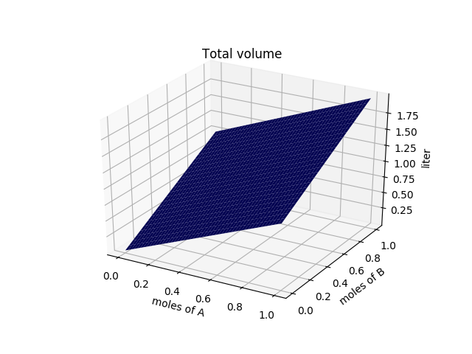
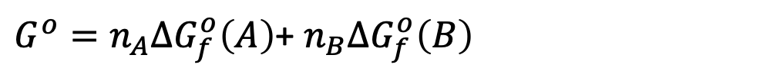
Total volumes of solutions in this state space
$$n_{B}$$
$$n_{A}$$
${{G^{o}=n}_{A}∆G}_{f}^{o}\left(A\right)$+ ${n_{B}∆G}_{f}^{o}\left(B\right)$

Slide 8

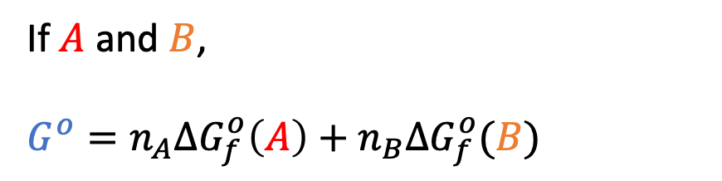
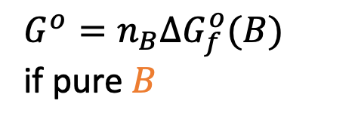
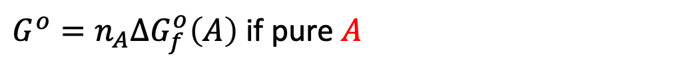
Gibbs energy in this new state space
If $A$ and $B$,
${{G^{o}=n}_{A}∆G}_{f}^{o}\left(A\right)+{n_{B}∆G}_{f}^{o}(B)$
${{G^{o}=n}_{B}∆G}_{f}^{o}(B)$
if pure $B$
$$n_{B}$$
$G^{o}$ is the unmixed Gibbs energy!
$$n_{A}$$
${{G^{o}=n}_{A}∆G}_{f}^{o}\left(A\right)$ if pure $A$

Slide 9
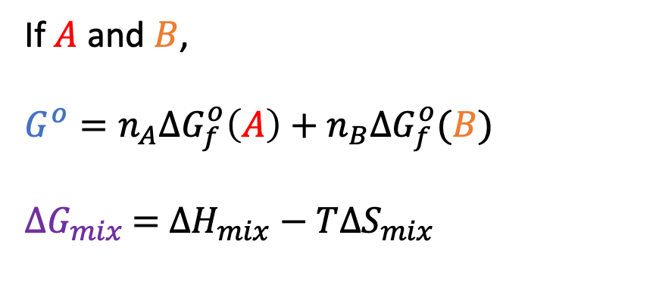
Gibbs energy in this new state space
If $A$ and $B$,
${{G^{o}=n}_{A}∆G}_{f}^{o}\left(A\right)+{n_{B}∆G}_{f}^{o}(B)$
${∆G}_{mix}$ $=$ $∆H_{mix}−T∆S_{mix}$
${{G^{o}=n}_{B}∆G}_{f}^{o}(B)$
if pure $B$
$$n_{B}$$
$$n_{A}$$
${{G^{o}=n}_{A}∆G}_{f}^{o}\left(A\right)$ if pure $A$

Slide 10
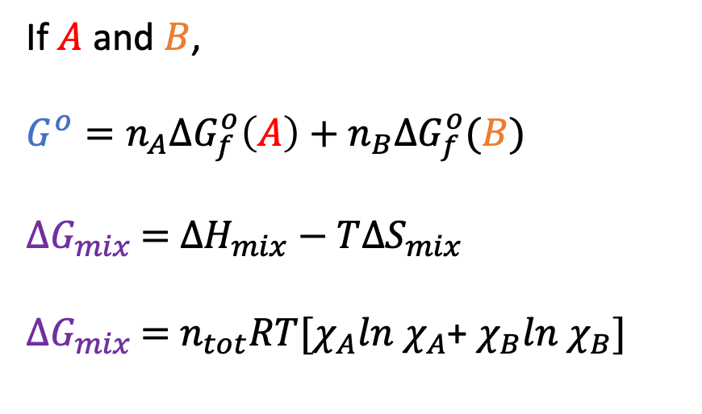
Gibbs energy in this new state space
If $A$ and $B$,
${{G^{o}=n}_{A}∆G}_{f}^{o}\left(A\right)+{n_{B}∆G}_{f}^{o}(B)$
${∆G}_{mix}$ $=$ $∆H_{mix}−T∆S_{mix}$
${∆G}_{mix}$ $=$ $n_{tot}RT[χ_{A}ln$ $χ_{A}$+ $χ_{B}ln$ $χ_{B}]$
${{G^{o}=n}_{B}∆G}_{f}^{o}(B)$
if pure $B$
$$n_{B}$$
$$n_{A}$$
${{G^{o}=n}_{A}∆G}_{f}^{o}\left(A\right)$ if pure $A$

Slide 11
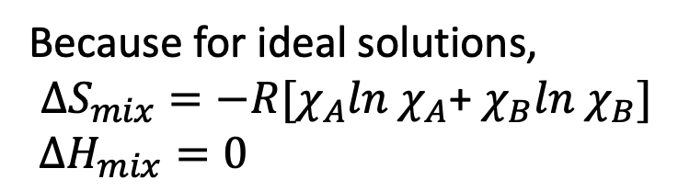
Gibbs energy in this new state space
If $A$ and $B$,
${{G^{o}=n}_{A}∆G}_{f}^{o}\left(A\right)+{n_{B}∆G}_{f}^{o}(B)$
${∆G}_{mix}$ $=$ $∆H_{mix}−T∆S_{mix}$
${∆G}_{mix}$ $=$ $n_{tot}RT[χ_{A}ln$ $χ_{A}$+ $χ_{B}ln$ $χ_{B}]$
${{G^{o}=n}_{B}∆G}_{f}^{o}(B)$
if pure $B$
$$n_{B}$$
Because for ideal solutions,
$$∆S_{mix}=−R[χ_{A}ln χ_{A}\text{+} χ_{B}ln χ_{B}]$$
$∆H_{mix}=0$
$$n_{A}$$
${{G^{o}=n}_{A}∆G}_{f}^{o}\left(A\right)$ if pure $A$

Slide 12
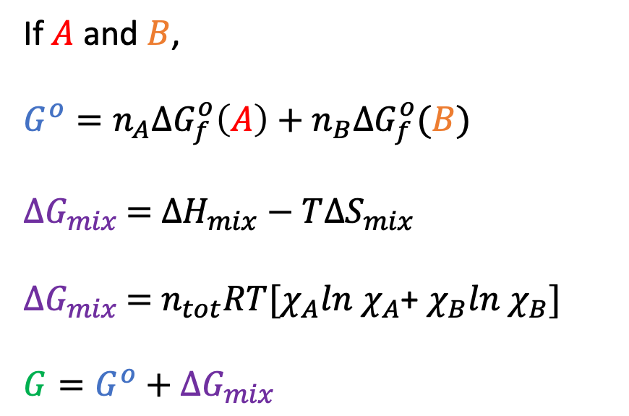
Gibbs energy in this new state space
If $A$ and $B$,
${{G^{o}=n}_{A}∆G}_{f}^{o}\left(A\right)+{n_{B}∆G}_{f}^{o}(B)$
${∆G}_{mix}$ $=$ $∆H_{mix}−T∆S_{mix}$
${∆G}_{mix}$ $=$ $n_{tot}RT[χ_{A}ln$ $χ_{A}$+ $χ_{B}ln$ $χ_{B}]$
$G=G^{o}+$ ${∆G}_{mix}$
${{G^{o}=n}_{B}∆G}_{f}^{o}(B)$
if pure $B$
$$n_{B}$$
$$n_{A}$$
${{G^{o}=n}_{A}∆G}_{f}^{o}\left(A\right)$ if pure $A$

Slide 13
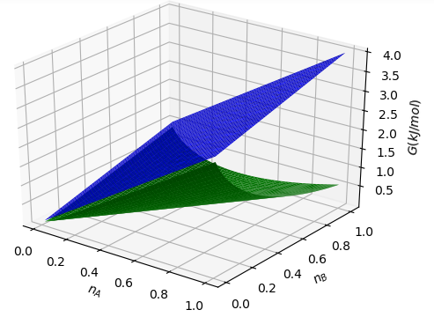
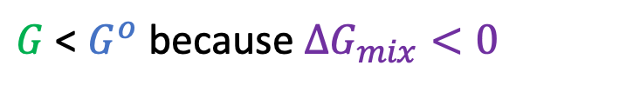
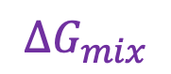



This is what the CGI is about today
${G=G}^{o}+∆G_{mix}$
$$G^{o}$$
$$∆G_{mix}$$
$$G$$
$G$ < $G^{o}$ because $∆G_{mix}<0$

Slide 14
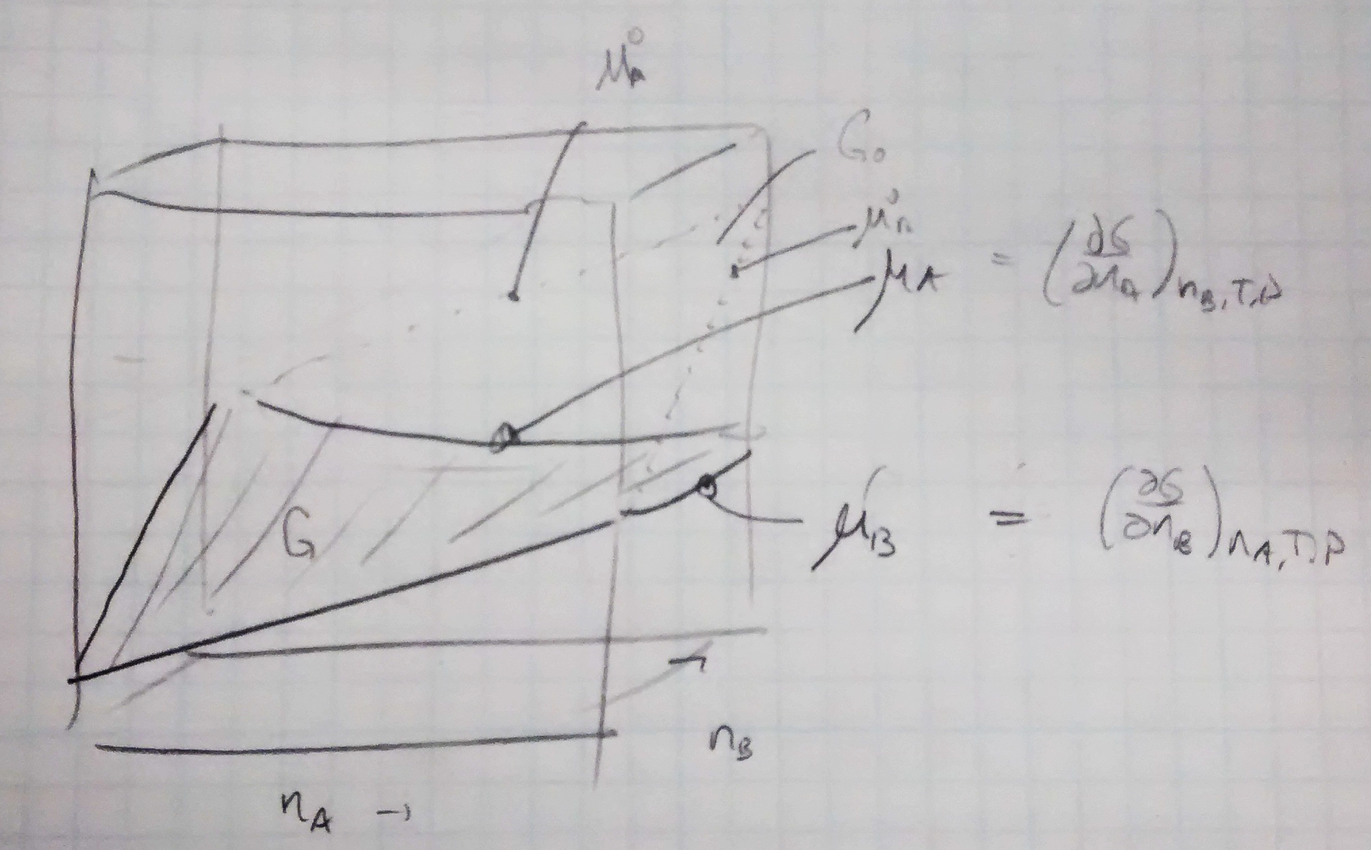
How I used to teach this

Slide 15
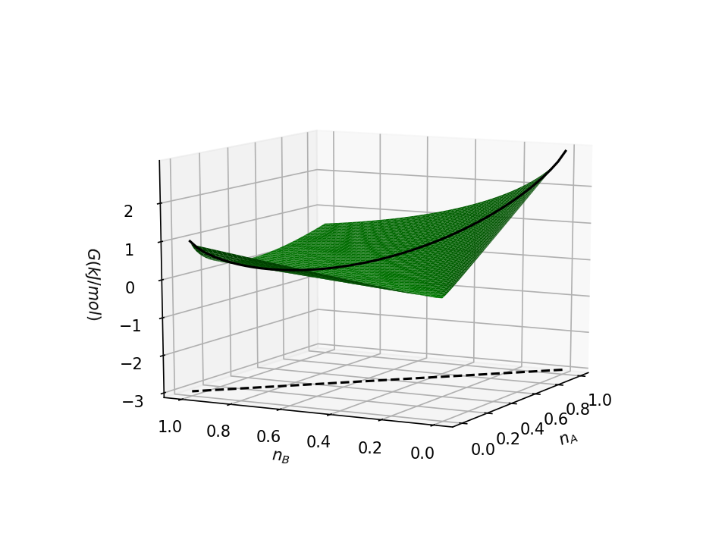
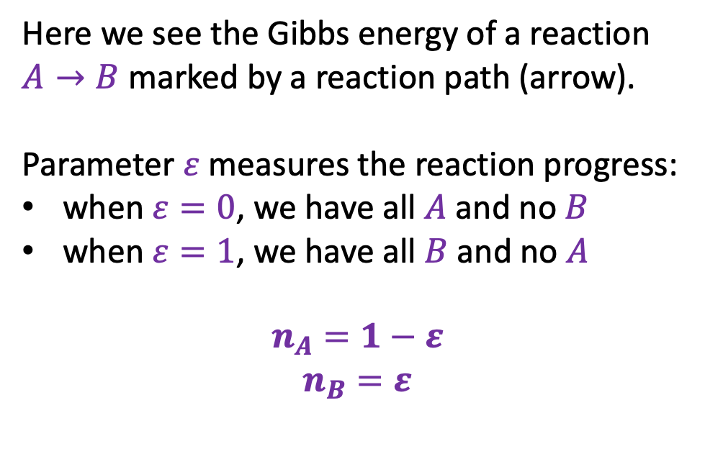

Why … Gibbs energy along a reaction path
Here we see the Gibbs energy of a reaction $A→B$ marked by a reaction path (arrow).
Parameter $ε$ measures the reaction progress:
when $ε=0$, we have all $A$ and no $B$
when $ε=1$, we have all $B$ and no $A$
$$n_{A}=1−ε$$
$$n_{B}=ε$$
$$ε$$

Slide 16
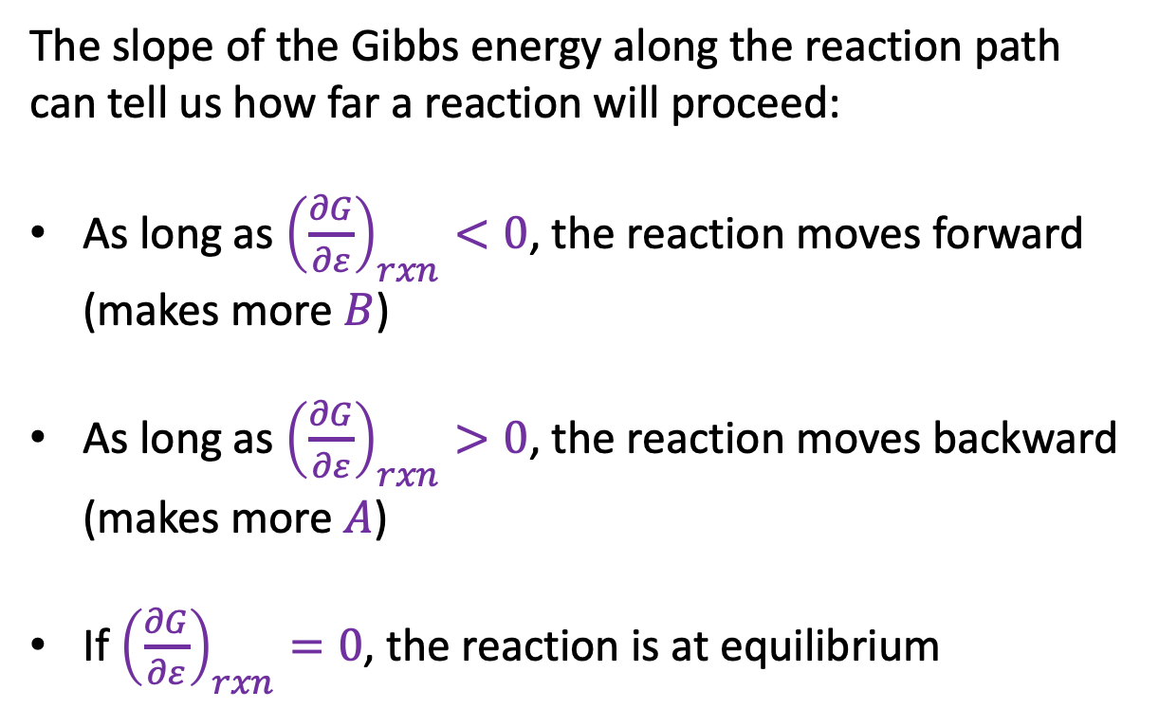
Slope of the Gibbs energy along the reaction path
The slope of the Gibbs energy along the reaction path can tell us how far a reaction will proceed:
As long as ${\left(\frac{∂G}{∂ε}\right)}_{rxn}<0$, the reaction moves forward (makes more $B$)
As long as ${\left(\frac{∂G}{∂ε}\right)}_{rxn}>0$, the reaction moves backward (makes more $A$)
If ${\left(\frac{∂G}{∂ε}\right)}_{rxn}=0$, the reaction is at equilibrium
$$ε$$

Slide 17

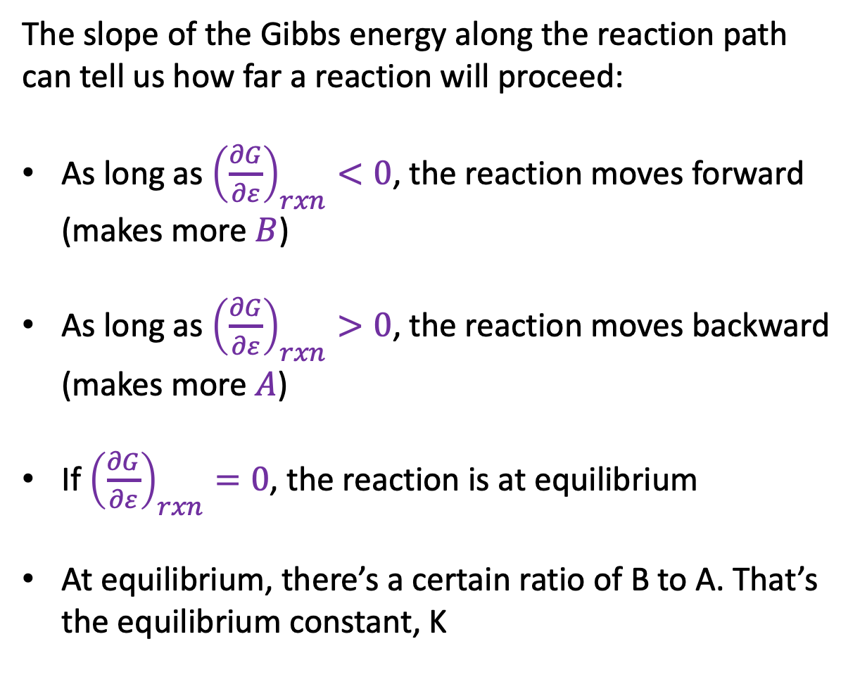
Slope of the Gibbs energy along the reaction path
The slope of the Gibbs energy along the reaction path can tell us how far a reaction will proceed:
As long as ${\left(\frac{∂G}{∂ε}\right)}_{rxn}<0$, the reaction moves forward (makes more $B$)
As long as ${\left(\frac{∂G}{∂ε}\right)}_{rxn}>0$, the reaction moves backward (makes more $A$)
If ${\left(\frac{∂G}{∂ε}\right)}_{rxn}=0$, the reaction is at equilibrium
At equilibrium, there’s a certain ratio of B to A. That’s the equilibrium constant, K
$$ε$$

